Slide 1

OPERATING SYSTEMS
Disk Scheduling

Slide 2
Disk Scheduling

Slide 3
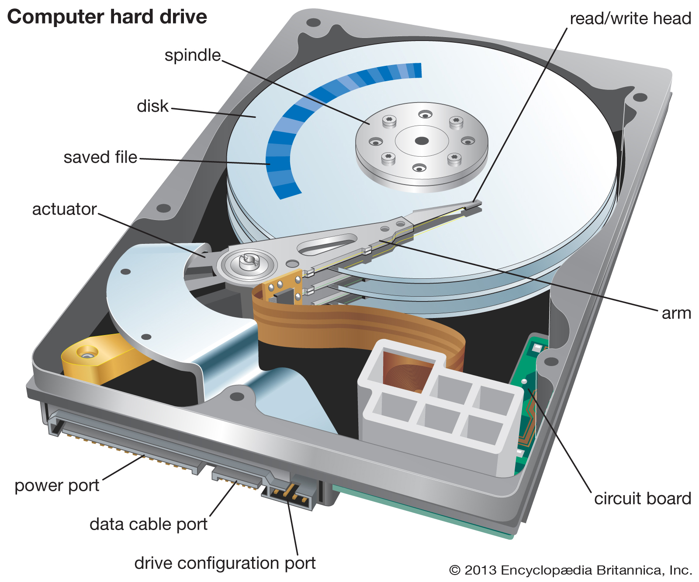
Magnetic Disks

Slide 4
Each platter (Disk) has a flat circular shape like a CD or DVD.
Generally diameter range from 1.8 to 5.25 inches.
Both surface are covered by a magnetic material.
R/W head is attached to disk arm.
Surface of disk are divided into circular tracks.
Tracks are further divided into sectors.
Seek time: Time required to move the R/W head on the desired track.
Disk Scheduling: In case of multiple I/O request, disk scheduling algorithm must decide which request must be executed first.

Slide 5
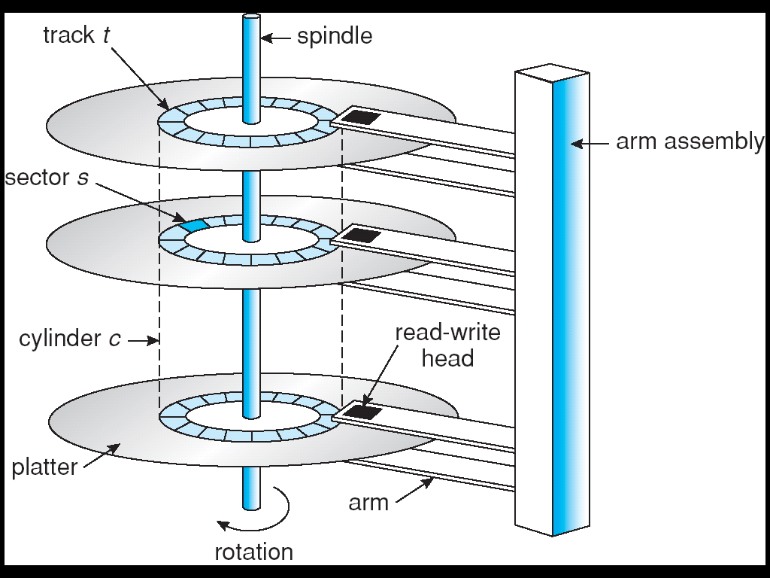
Disk Structure

Slide 6
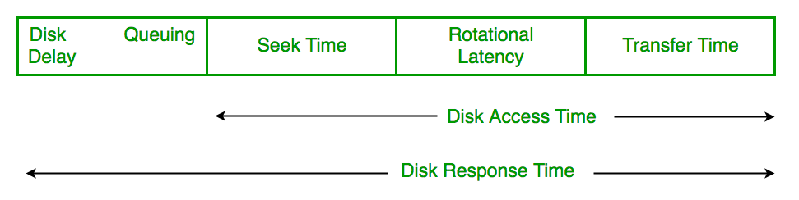

Slide 7
Seek Time
Seek time is the time taken in locating the disk arm to a specified track where the read/write request will be satisfied.
Rotational Latency
It is the time taken by the desired sector to rotate itself to the position from where it can access the R/W heads.
Transfer Time
It is the time taken to transfer the data.

Slide 8
Disk Access Time
Disk access time is given as,
Disk Access Time = Rotational Latency + Seek Time + Transfer Time
Disk Response Time
It is the average time to spent by each request waiting for the IO operation.

Slide 9
Disk Scheduling
As we know, a process needs two type of time, CPU time and IO time. For I/O, it requests the Operating system to access the disk.
However, the operating system must be fare enough to satisfy each request and at the same time, operating system must maintain the efficiency and speed of process execution.
The technique that operating system uses to determine the request which is to be satisfied next is called disk scheduling.

Slide 10
Purpose of Disk Scheduling
The main purpose of disk scheduling algorithm is to select a disk request from the queue of IO requests and decide the schedule when this request will be processed.

Slide 11
Disk Scheduling Algorithms
FCFS scheduling algorithm
SSTF (shortest seek time first) algorithm
SCAN scheduling
C-SCAN scheduling
LOOK Scheduling
C-LOOK scheduling

Slide 12
Disk Scheduling Algorithms
We illustrate them with a I/O request queue (cylinders are between 0-199): queue = 98, 183, 37, 122, 14, 124, 65, 67
head starts at 53

Slide 13
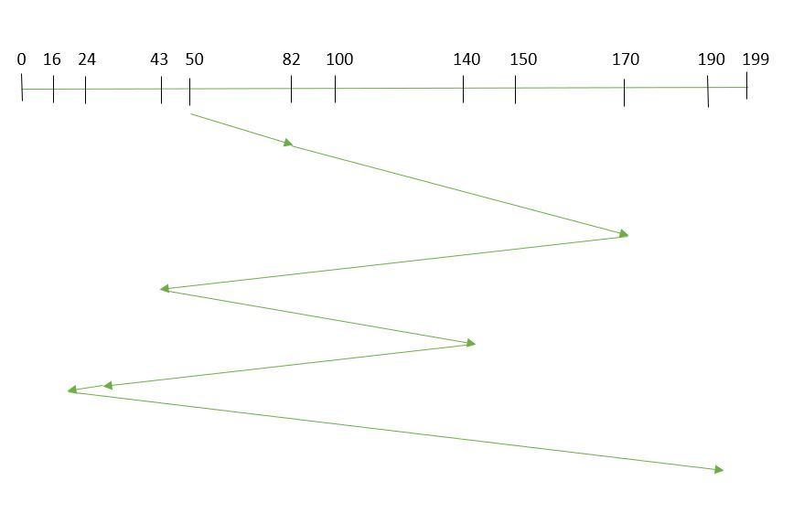
Suppose the order of request is- (82,170,43,140,24,16,190) And current position of Read/Write head is : 50
So, total seek time: =(82-50)+(170-82)+(170-43)+(140-43)+(140-24)+(24-16)+(190-16) =642

Slide 14
Advantages:
Every request gets a fair chance
No indefinite postponement
Disadvantages:
Does not try to optimize seek time
May not provide the best possible service

Slide 15
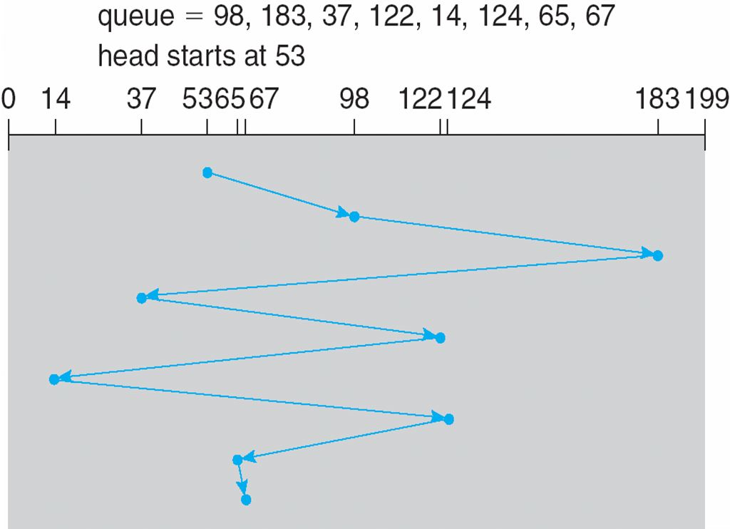
First Come First Serve (FCFS) Example
Illustration shows total head movement of 640 cylinders.

Slide 16
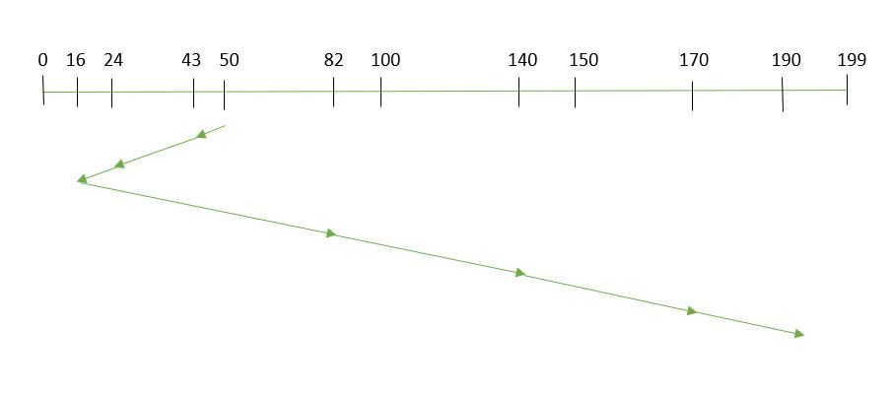
SSTF (Shortest Seek Time First)
Suppose the order of request is- (82,170,43,140,24,16,190) And current position of Read/Write head is : 50
So, total seek time: =(50-43)+(43-24)+(24-16)+(82-16)+(140-82)+(170-40)+(190-170) =208

Slide 17
SCAN
SCAN algorithm the disk arm moves into a particular direction and services the requests coming in its path and after reaching the end of disk, it reverses its direction and again services the request arriving in its path.
This algorithm works as an elevator and hence also known as elevator algorithm.
As a result, the requests at the midrange are serviced more and those arriving behind the disk arm will have to wait.

Slide 18
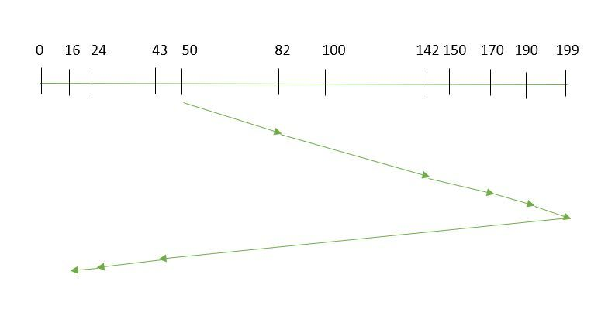
Suppose the requests to be addressed are-82,170,43,140,24,16,190. And the Read/Write arm is at 50, and it is also given that the disk arm should move “towards the larger value”.
seek time is calculated as:
=(199-50)+(199-16) =332
Advantages:
High throughput
Low variance of response time
Average response time

Slide 19
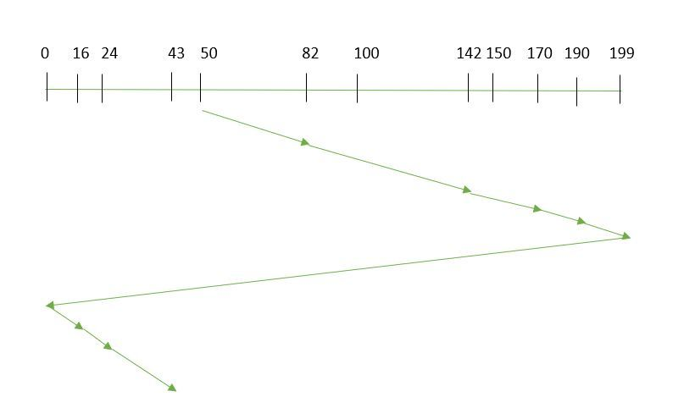
CSCAN
Suppose the requests to be addressed are-82,170,43,140,24,16,190. And the Read/Write arm is at 50, and it is also given that the disk arm should move “towards the larger value”.
Seek time is calculated as:
=(199-50)+(199-0)+(43-0) =391

Slide 20
LOOK:
It is similar to the SCAN disk scheduling algorithm except for the difference that the disk arm in spite of going to the end of the disk goes only to the last request to be serviced in front of the head and then reverses its direction from there only.
Thus it prevents the extra delay which occurred due to unnecessary traversal to the end of the disk.

Slide 21
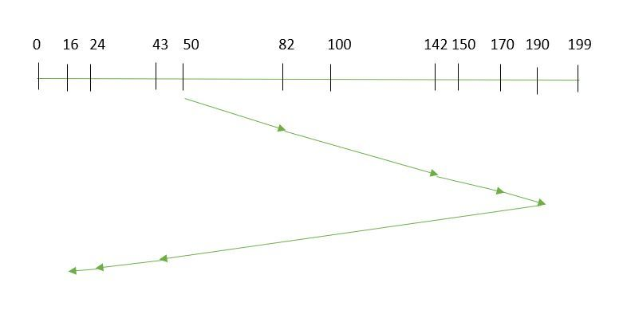
Suppose the requests to be addressed are-82,170,43,140,24,16,190. And the Read/Write arm is at 50, and it is also given that the disk arm should move “towards the larger value”.
seek time is calculated as:
=(190-50)+(190-16) =314

Slide 22
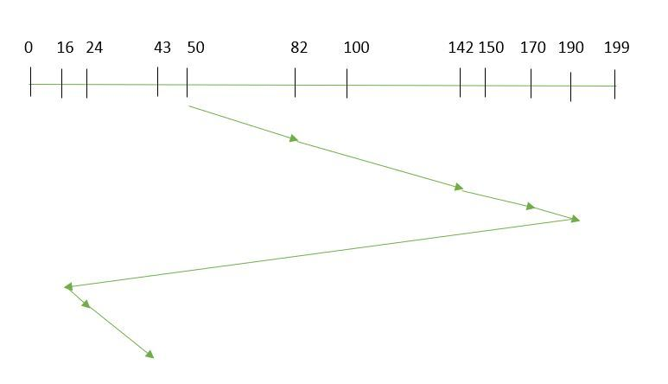
CLOOK
seek time is calculated as:
=(190-50)+(190-16)+(43-16) =341

